Slide 1
British Airways
Predictive model and its results
07/05/2024

Slide 2


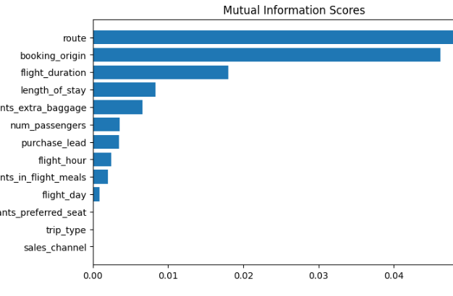
predictive model to understand factors that influence buying behaviors
We have trained the data set with Random forest classifier model and received
ACCURACY: 85.09
AUC score: 0.558
Route
Booking origin
Flight duration
Wants_extra_baggage
Length_of_stay
There are the Top 5 Features which influence
Customer buying behavior
We need to increase the AUC score.

